Slide 1

Intro to NServiceBus
2 – Getting and Installing

Slide 2
Steps
Create a project, add NServiceBus references
Create a message
Create a service endpoint
Create a message handler
Add persistence
Create a host
Send a message

Slide 3
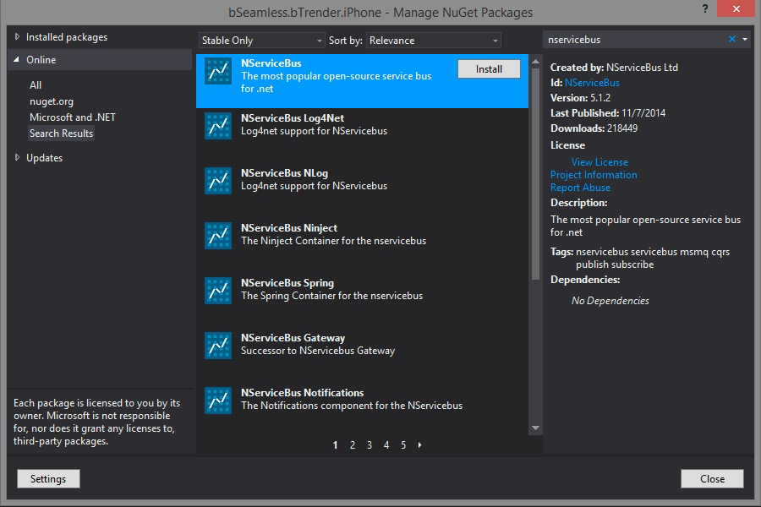
NuGet install (for the app only)

Slide 4
Packages
NServiceBus.Interfaces
NServiceBus
NServiceBus.Host
NServiceBus.Testing

Slide 5
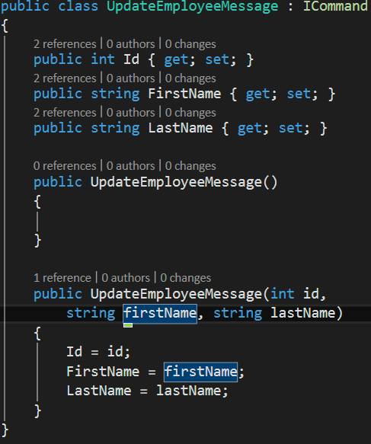
Message
Any object based on IMessage
“Commands” are based on ICommand
NServiceBus applies command semantics to those messages (in the mindset of CQRS)

Slide 6
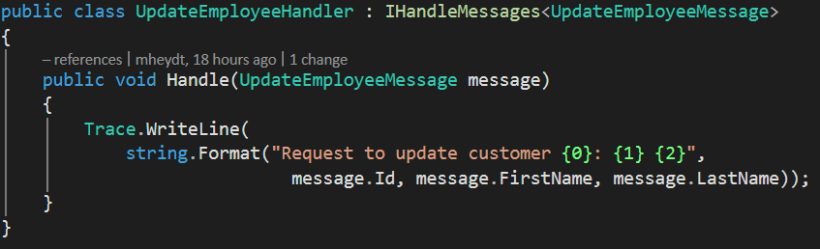
Receiver
Implements IHandleMessage

Slide 7
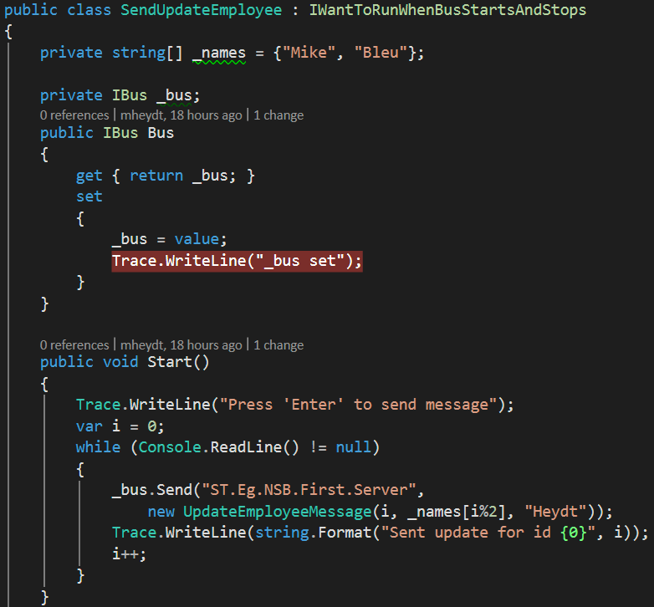
Sender
Uses “Bus.Send”

Slide 8
And some configuration
To specify addresses for endpoints

Slide 9
Summary
Basic One-way messaging example
Simple implementation of messaging patterns

Slide 10
Demo: One way messaging app

